Slide 1
KNAPSACK PROBLEM

Slide 2
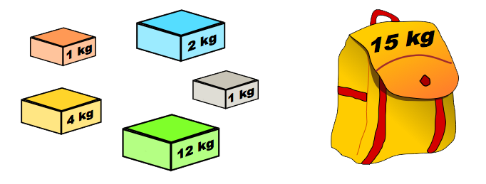
WHAT IS KNAPSACK PROBLEM
The knapsack means a BAG or CONTAINER
Given a set of items, each with a weight and a value,
determining the number of each item to include in a
collection so that the total weight is less than or equal to a given limit and the total value is as large as possible.

Slide 3
KNAPSACK FORMULA
V(i , j) = { 0 if i =0,j=0
V( i -1 , j ) if W [ i ] > j
Max[V( i -1, j ),V( i - 1 , j – W [ i ])+P [ i ] if W[ i ]< = j
// Profits (stored in array P)
// Weights (stored in array w)
// Number of distinct items (n)
// Knapsack capacity (W)

Slide 4
KNAPSACK ALGORITHM
for i from 0 to n do:
for j from 0 to m do:
if( i =0 or j=0)
V( i ,j )
else
if w[i] > j then:
V[i, j] := v[i-1, j]
else:
v[i, j] := max(v[i-1, j], v[i-1, j-W[i]] + P[i])

Slide 5
ThAnKu…….
By,
Ayyappa
Prmod kumar
Praveen kumar
Sagar M V

